Slide 1
Unit:1
Basics of Computer Graphics
Marks :6

Slide 2
What is Computer Graphics?
Computer graphics is an art of drawing pictures on computer screens with the help of programming. It involves computations, creation, and manipulation of data.
Computer graphics is process of generation of images of virtual scenes using computer hardware.
Computer graphics is the use of computer hardware & software to create, manipulate & present picture &images.
Computer graphics is pictorial representation & manipulation of data by a computer.

Slide 3
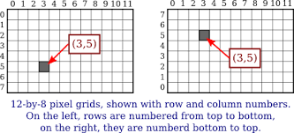
Cont.
Pixel: The smallest element of an image.
Resolution: refers to the total number of count of pixels in an digital image. Example: If an image has M rows and N columns, then its resolution can be defined as M X N.
Monitor resolution of 800 x 600, 640 x 480.

Slide 4
Cont.
Pixel: The smallest element of an image.
Resolution: refers to the total number of count of pixels in an digital image. Example: If an image has M rows and N columns, then its resolution can be defined as M X N.
Monitor resolution of 800 x 600, 640 x 480.
Graphics Mode: graphics mode classified into-
Text Mode
Graphics Mode

Slide 5
Text Mode Functions
puts( ): It display string at cursor position .
putch( ): It displays single character
window( ): Used to create the window on screen.
gotoxy( ):It position the cursor at x, y co-ordinate position.
delline( ):It delete a line specified at cursor position.
inline( ):it insert the blank line at specified position.

Slide 6
Text Mode Functions
textbackground(): It changes text background of text.
moveto( ): It moves the cursor to position which is specified in function.
textcolor( ):used to set color of text.

Slide 7
Graphics Mode function
initgraph(): It initialize the graphics mode
Syntax: initgraph ( int driver, int mode, char path);
Driver: it specifies the graphics driver name which is used to interface with display adapter.
It specifies the different graphics mode. EGA, VGA,SVGA.
Path: It specifies the path name of graphics driver. Graphics driver contain BGI extension files.
Syntax: initgraph(&gd,&gm,”C:\\tc\\bgi”);

Slide 8
Cont.
closegraph ( ):It shunt down graphics mode and return to text mode.
Syntax: closegraph();

Slide 9
Display Devices
The primary output device in a graphical system is the video monitor.
There are two types of video monitors:
Monochrome display monitor ( Black & white)
Color display monitor
The main element of a video monitor is the Cathode Ray Tube (CRT).
The operation of CRT is very simple −
The CRT is vacuum glass tube.

Slide 10
Cont.
The electron gun emits a beam of electrons (cathode rays).
The electron beam passes through focusing and deflection systems that direct it towards specified positions on the phosphor-coated screen.
When the beam hits the screen, the phosphor emits a small spot of light at each position contacted by the electron beam.
It redraws the picture by directing the electron beam back over the same screen points quickly.

Slide 11
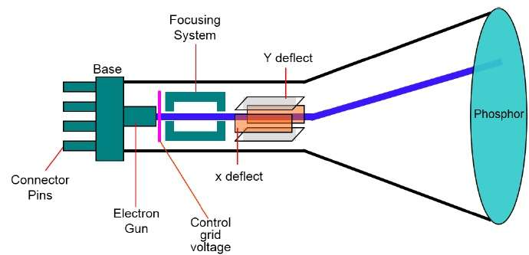
Cathode Rays Tube
Fig: Cathode Rays Tube

Slide 12
Cont.
There are two ways by which we can display an object on the screen:
Raster Scan Display
Random scan display

Slide 13
Raster Scan Graphics
The electron beam is swept across the screen, one row at a time from top to bottom.
As the electron beam moves across each row, the beam intensity is turned on and off to create a pattern of illuminated spots.
Picture definition is stored in memory area called the Refresh Buffer or Frame Buffer.
This memory area holds the set of intensity values for all the screen points.
Stored intensity values are then retrieved from the refresh buffer and “painted” on the screen one row (scan line)

Slide 14
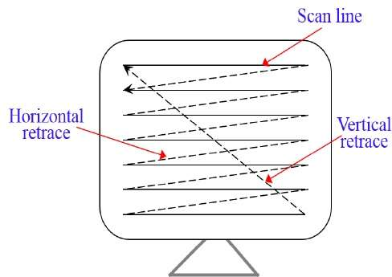
Cont.
Each screen point is referred to as a pixel (picture element) or pel.
At the end of each scan line, the electron beam returns to the left side of the screen to begin displaying the next scan line.
Fig: Raster Scan Display

Slide 15
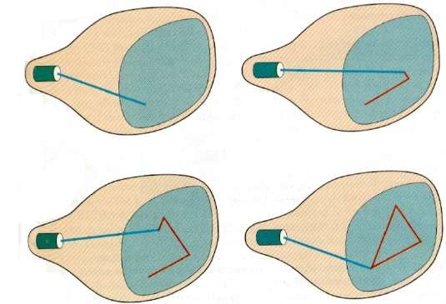
Random Scan Display
The electron beam is directed only to the part of the screen where the picture is to be drawn rather than scanning from left to right and top to bottom as in raster scan

Slide 16
Cont.
Picture definition is stored as a set of line-drawing commands in an area of memory referred to as the refresh display file.
To display a specified picture, the system cycles through the set of commands in the display file, drawing each component line in turn.
After all the line-drawing commands are processed, the system cycles back to the first line command in the list.

Slide 17
Difference between Raster & Random scan
Raster scan
Random scan
In raster scan ,beam is moved all over the screen on scan line at a time from top to bottom & then back to top.
The refresh process is independent of the complexity of the image.
Scan conversion is required.
Scan conversion h/w is required.
Cost is low.
Raster display has ability to display area filled with solid colors.
In random scan ,the beam is moved between end points of graphics primitives.
It flickers when the no. of primitives in buffer becomes too large.
Scan conversion is not required.
Scan conversion h\w is not required.
Cost is high.
Draws only lines & characters.

Slide 18
Color Video Monitor
It displaying color pictures has been used with random-scan monitors.
The basic principal behind colored displays is that combining 3 basic color- Red, Blue & Green can produce every color.
Video color monitors are:
Shadow Mask Technique
Beam Penetration Technique.

Slide 19
Beam penetration technique
The CRT is similar to simple CRT but it make the use of multi colored phosphorus of no. layers.
It is used with random scan monitor.
The CRT screen is coated with two phosphor layers. The red phosphorus coated screen deposited behind green phosphorus.
If low speed beam strike on the screen, then only red colored phosphorus is activated.
High speed beam strike on the screen then green colored phosphorus is activated.

Slide 20
Cont.
The beam with intermediate speed gives red & green combination.
The beam accelerating voltage control the speed of beam & produce different screen color.
Drawback:
Limited range of color.
Need to change beam accelerating voltage which is difficult.

Slide 21
Shadow Mask Technique
It is commonly used in raster scan system.
It produce much wider range of color than beam penetration method.
In this type of CRT metal plate having small round holes in triangular pattern called shadow mask which is inserted behind phosphorous layer.
Electron gun is consist of 3 electron guns grouped in triangle.
Each gun responsible for red green & blue component of light of phosphorous.
These 3 electron gun strike the screen in three slightly different spots.
By varying intensity of three electron beams we can retain different colors.

Slide 22
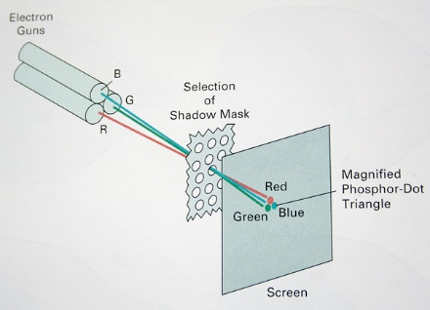
Cont.

Slide 23

Flat Panel Display
Flat panel display having small volume, light in weight and required less power as compare to CRT.
Current use of flat panel displays include small TV monitors, calculators, packet video games.
Flat panel display is classified into two categories:
Emissive display
Non-emissive display

Slide 24
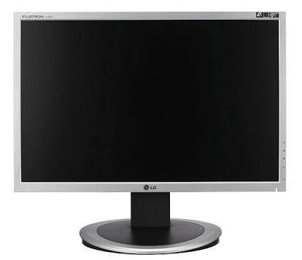
Cont.
Emissive display convert electrical energy into light.
Examples of emissive display are plasma panel display, LED
Non –emissive display convert sunlight into graphics pattern.
Example of Non emissive display is LCD

Slide 25
Cont.
Advantage:
Light weight , less bulky device.
Produce flicker free image
Refreshing not require.
Disadvantage:
Poor resolution
Very costly

Slide 26
Light Emitting Diode
LED Display (light-emitting diode display) is a screen display technology that uses a panel of LEDs as the light source.
LED screen are flat display which

Slide 27


Light Emitting Diode

Slide 28
Liquid Crystal Display
Liquid crystal material is filled in between two plates.
One plates have horizontal transparent conductor & other end glass plate have vertical polarizer & vertical conductors are built into it
Polarizer light passing through material is twisted so that it will pass through opposite polarizer.
The light is reflected back to viewer.
To turn OFF pixel, we apply voltage to two interesting conductor to align molecules so that light is not twisted.
Picture definition are stored in refresh buffer.

Slide 29
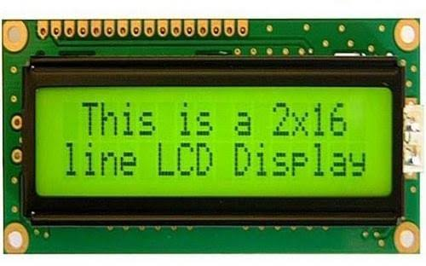
Liquid Crystal Display
Liquid crystal material is filled in between two plates.
One plates have horizontal transparent conductor & other end glass plate have vertical polarizer & vertical conductors are built into it
Polarizer light passing through material is twisted so that it will pass through opposite polarizer.

Slide 30
Bitmap &Vector based Graphics
Before image can be displayed on the screen it must be created by computer program in special part of computer memory call frame buffer.
producing image in frame buffer is to use block of memory called bitmap to store small & detailed figure.
There are 2 types of computer graphics:
Bitmapped graphics
Vector based graphics
Bitmapped graphics is computer graphics that r stored as collection of bits in memory location corresponding pixels on the screen.

Slide 31
Cont.
In bitmapped images are treated as collection of dots
Within computer memory , bitmapped graphics images are treated as array of bits that describe characters of individual pixels.
In vector display

Slide 32
Display File interpreter
In raster scan display image information is stored in frame buffer.
Frame buffer stores intensity values of all pixels on screen.
Vector (random) only line commands necessary to make picture are stored.
These commands are stored in file called display file.
Picture information firstly stored in display file in the form of commands
Some program execute these commands & convert them into appropriate image on screen.
The program which convert these commands into actual picture is called display file interpreter.
It serve as interface between graphics program & display device.

Slide 33
Display File Structure
Display file contains series of commands to draw required picture.
These commands are made up of two parts:
Operation code(op code)
Operands
op code identifies what type of commands it is & operands provide coordinates of point(x ,y) to process commands.
Each commands require 3 array to store itself in display file.

Slide 34
Cont.
First array store [DF-OP] op code. second array store x coordinates, third stored y coordinates
Suppose we want to display 3 commands from display file .
Suppose only basic commands are used like LINE & MOVE ,op code for this commands are 1 for MOVE commands,2 for LINE.
DF-OP[] =1 means MOVE
DF=OP[]=2 means LINE.

Slide 35
Cont.
DF-OP | DF-X | DF-Y
1 | 3 | 3
2 | 5 | 5
1 | 10 | 10
2 | 15 | 15
(15,15)
Y
-Axis
(5,5)
(10,10)
(3,3)
X -axis

Slide 36
Application of Computer Graphics
Computer graphics user interfaces (GUIs) − User friendliness is one of the main factors underlying the success & popularity of the any system.
Plotting of graphics & charts: Most commonly used to create 2D &3D graphs in the form of graphs, pie-charts.
Cartography − Drawing maps.
Engineering drawings − mechanical, electrical, civil, etc. - Replacing the blueprints of the past.
Simulation & Animation: Use of graphics in simulation makes mathematic model & mechanical system more realistic & easy to study.

Slide 37
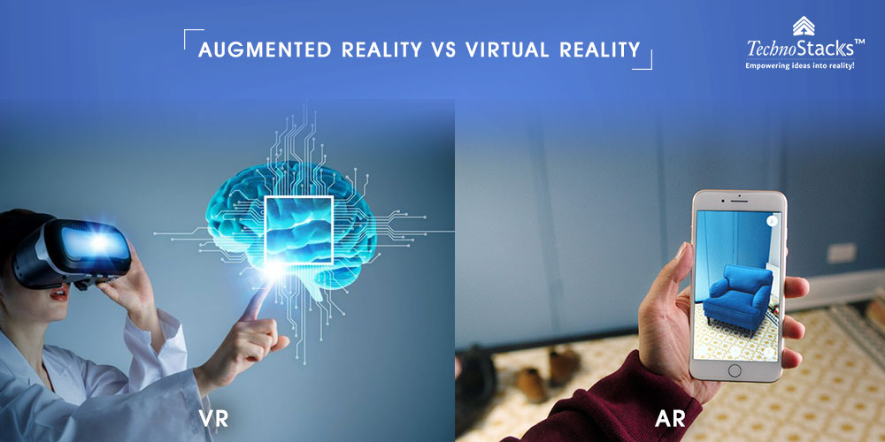
Augmented & virtual reality

Slide 38
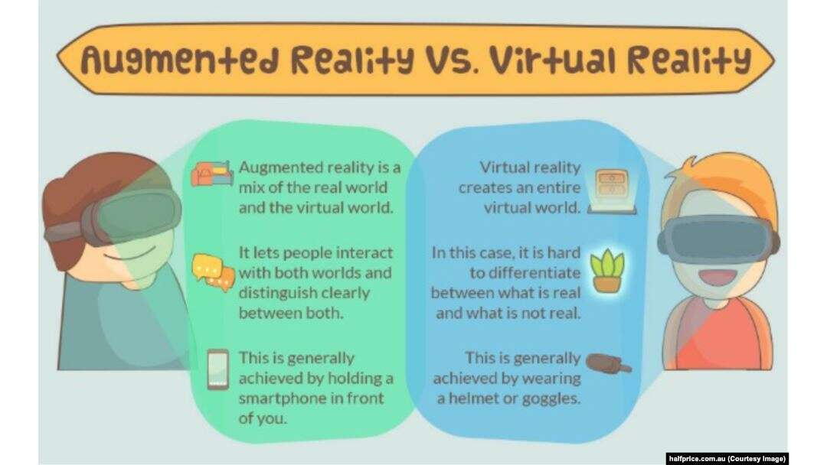
Augmented Vs virtual reality

Slide 39
Question Bank
Solve following questions( 2 Marks)
List any four application of computer graphics………………………..(R)
Draw the labeled diagram of CRT……………………………………………(R)
What is resolution of image……………………………( R)
List any two graphics mode function with syntax………………( R)
List any two text mode function with syntax…………………….( R )
Draw the labeled diagram of shadow mask CRT…………………(R )

Slide 40
Question Bank
What is frame buffer…………………………………………………..(R)
Define pixel……………………………………………….( R)
What are the different modes of computer graphics…………….( R)
List the properties of video display devices…………..( R)
Define virtual reality & augmented reality……………..( R)

Slide 41
Question Bank
Solve following questions( 4 Marks)
Explain raster scan display with block diagram…………….(U)
Explain the working principal of LCD /LED display……………..( U)
Differentiate between raster scan & random scan display…….( A)
Describe display file & its structure………………………..( U)
Describe shadow mask CRT technique with the help of diagram………(U)
Explain random scan display with diagram………….( U)

